Slide 1
Limits and multivariate functions

Slide 2
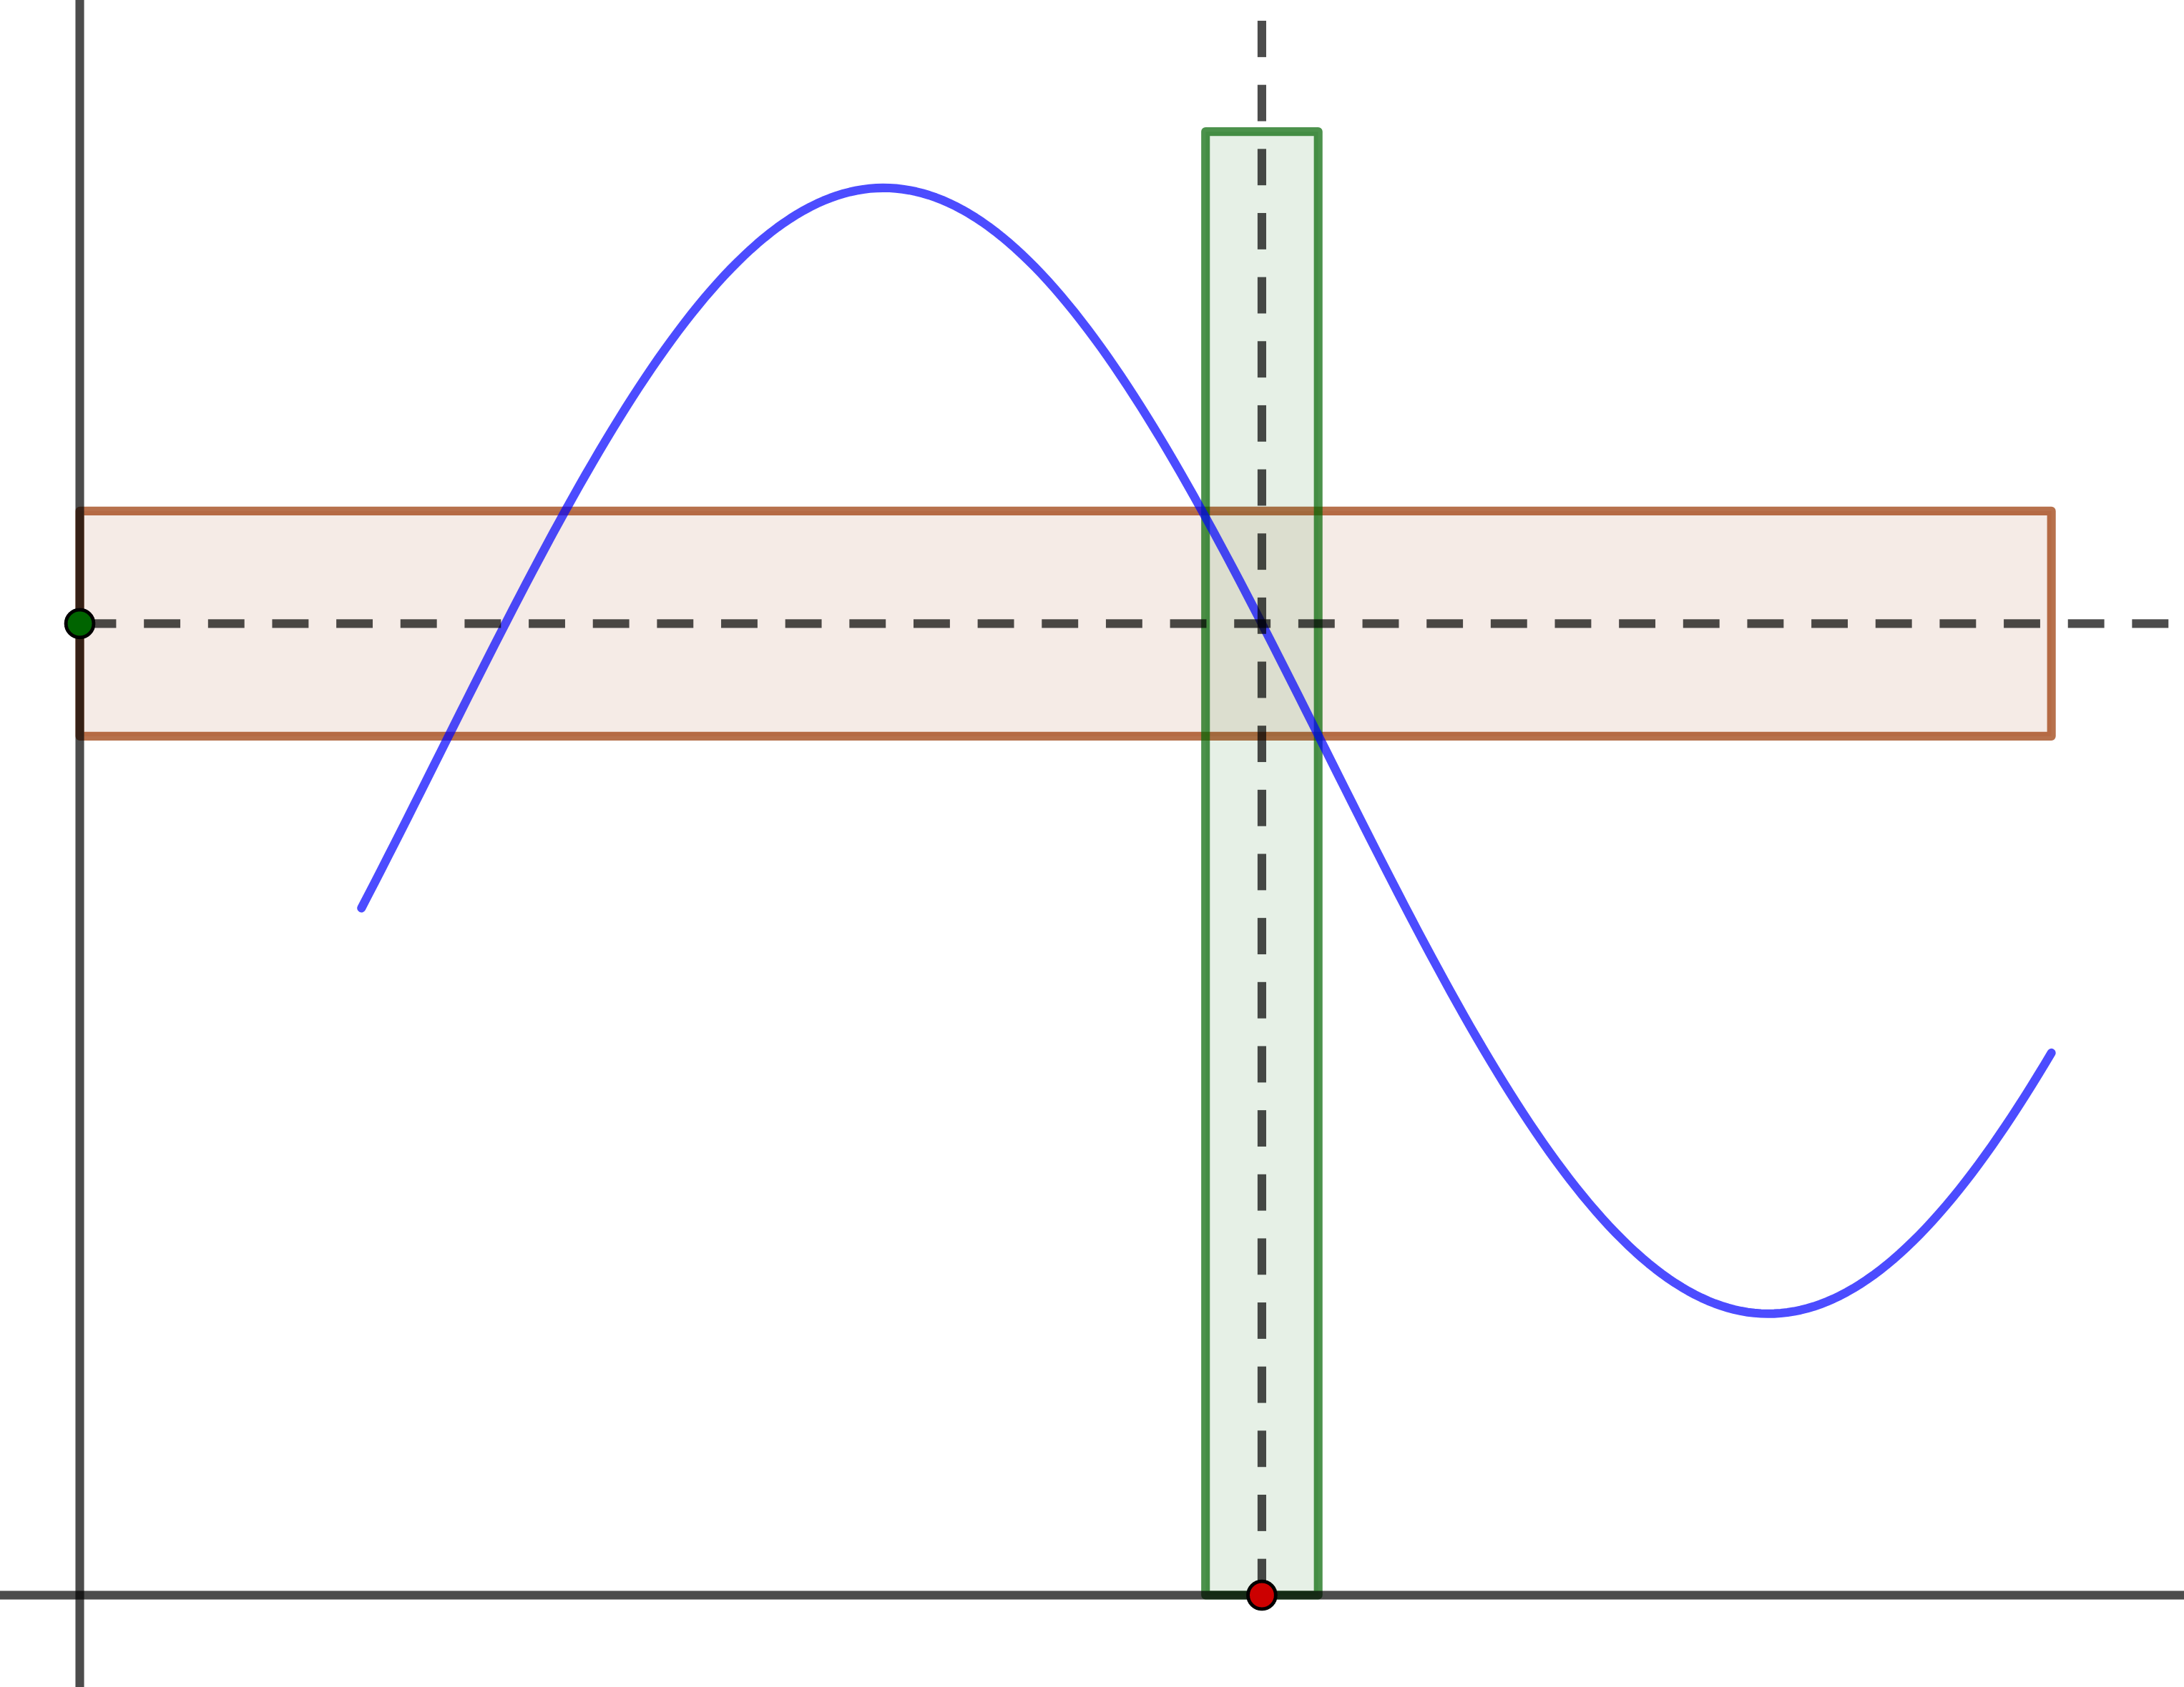
Introduction
We now know how to compute limits of sequences
How does it change in case of real instead of natural domain?
How to compare function asymptotic point-wise?
How does administering additional degree of freedom – second and other variables – affect the limit concept?

Slide 3
From sequences to functions

Slide 4
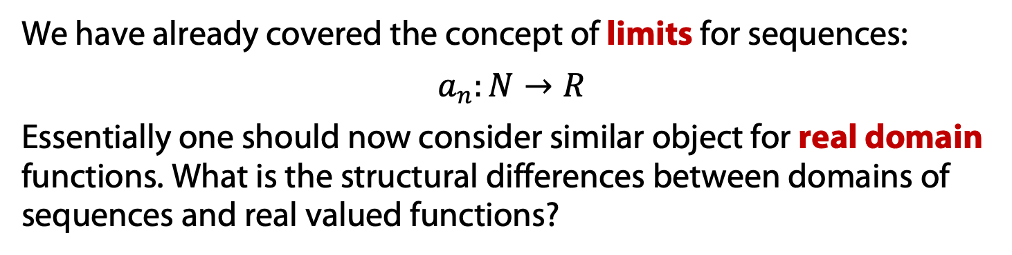
Real domain functions
We have already covered the concept of limits for sequences:
$$a_{n}:N→R$$
Essentially one should now consider similar object for real domain functions. What is the structural differences between domains of sequences and real valued functions?

Slide 5
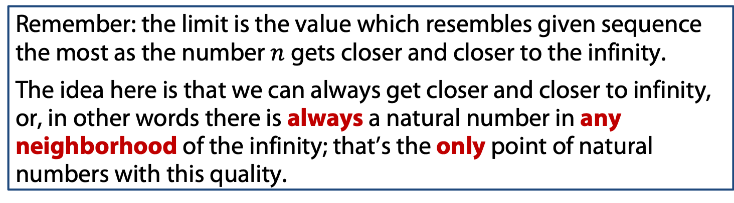
Real domain functions
We have already covered the concept of limits for sequences:
$$a_{n}:N→R$$
Essentially one should now consider similar object for real domain functions. What is the structural differences between domains of sequences and real valued functions?
Remember: the limit is the value which resembles given sequence the most as the number $n$ gets closer and closer to the infinity.
The idea here is that we can always get closer and closer to infinity, or, in other words there is always a natural number in any neighborhood of the infinity; that’s the only point of natural numbers with this quality.

Slide 6
Real domain functions
We have already covered the concept of limits for sequences:
$$a_{n}:N→R$$
Essentially one should now consider similar object for real domain functions. What is the structural differences between domains of sequences and real valued functions?
Remember: the limit is the value which resembles given sequence the most as the number $n$ gets closer and closer to the infinity.
The idea here is that we can always get closer and closer to infinity, or, in other words there is always a natural number in any neighborhood of the infinity; that’s the only point of natural numbers with this quality.
We defined here a limit point: as for the real numbers every point is a limit point, thus we can seek for the limit not only in case of infinity!

Slide 7
Function’s Limits

Slide 8
Function Limits
Let us try to extrapolate the definition for sequences:
“For any given deviation one could go as close to the limit point that the sequence would not deviate from the limit more then given.”

Slide 9
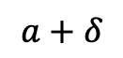
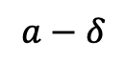
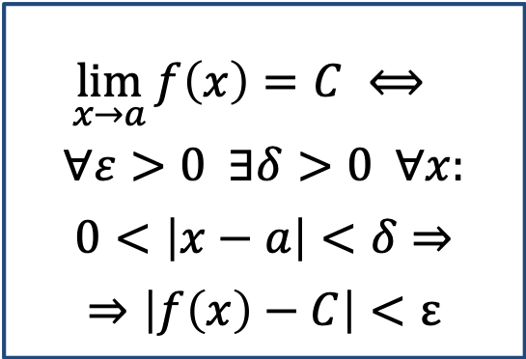
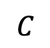
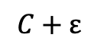
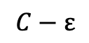
Function Limits
Let us try to extrapolate the definition for sequences:
“For any given deviation one could go as close to the limit point that the sequence would not deviate from the limit more then given.”
$$\lim_{x→a}{f\left(x\right)=C} ⟺$$
$$∀ε>0 ∃δ>0 ∀x:$$
$$0<\left|x−a\right|<δ⇒$$
$$⇒\left|f\left(x\right)−C\right|<ε$$
$$C+ε$$
$$C$$
$$C−ε$$
$$a−δ$$
$$a+δ$$
a

Slide 10
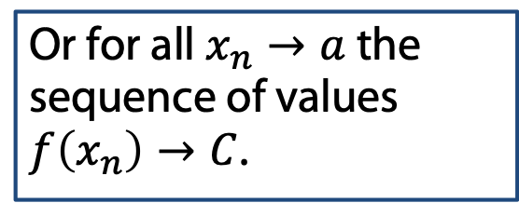
Function Limits
Let us try to extrapolate the definition for sequences:
“For any given deviation one could go as close to the limit point that the sequence would not deviate from the limit more then given.”
$$\lim_{x→a}{f\left(x\right)=C} ⟺$$
$$∀ε>0 ∃δ>0 ∀x:$$
$$0<\left|x−a\right|<δ⇒$$
$$⇒\left|f\left(x\right)−C\right|<ε$$
$$C+ε$$
$$C$$
$$C−ε$$
Or for all $x_{n}→a$ the sequence of values $f\left(x_{n}\right)→C$.
$$a−δ$$
$$a+δ$$
a

Slide 11
Function’s Limits: examples

Slide 12
Function’s limits: arithmetic

Slide 13
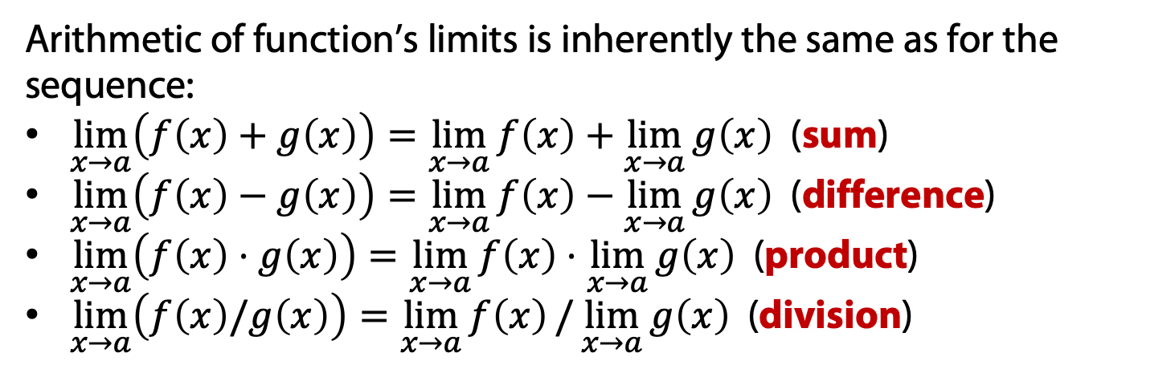
Function Limits: arithmetic
Arithmetic of function’s limits is inherently the same as for the sequence:
$\lim_{x→a}\left(f\left(x\right)+g\left(x\right)\right)=\lim_{x→a}{f\left(x\right)}+\lim_{x→a}{g\left(x\right)}$ (sum)
$\lim_{x→a}\left(f\left(x\right)−g\left(x\right)\right)=\lim_{x→a}{f\left(x\right)}−\lim_{x→a}{g\left(x\right)}$ (difference)
$\lim_{x→a}\left(f\left(x\right)⋅g\left(x\right)\right)=\lim_{x→a}{f\left(x\right)}⋅\lim_{x→a}{g\left(x\right)}$ (product)
$\lim_{x→a}\left(f\left(x\right)/g\left(x\right)\right)=\lim_{x→a}{f\left(x\right)}/\lim_{x→a}{g\left(x\right)}$ (division)
Remember: it’s only true if all the limits in the right hand side exist!

Slide 14
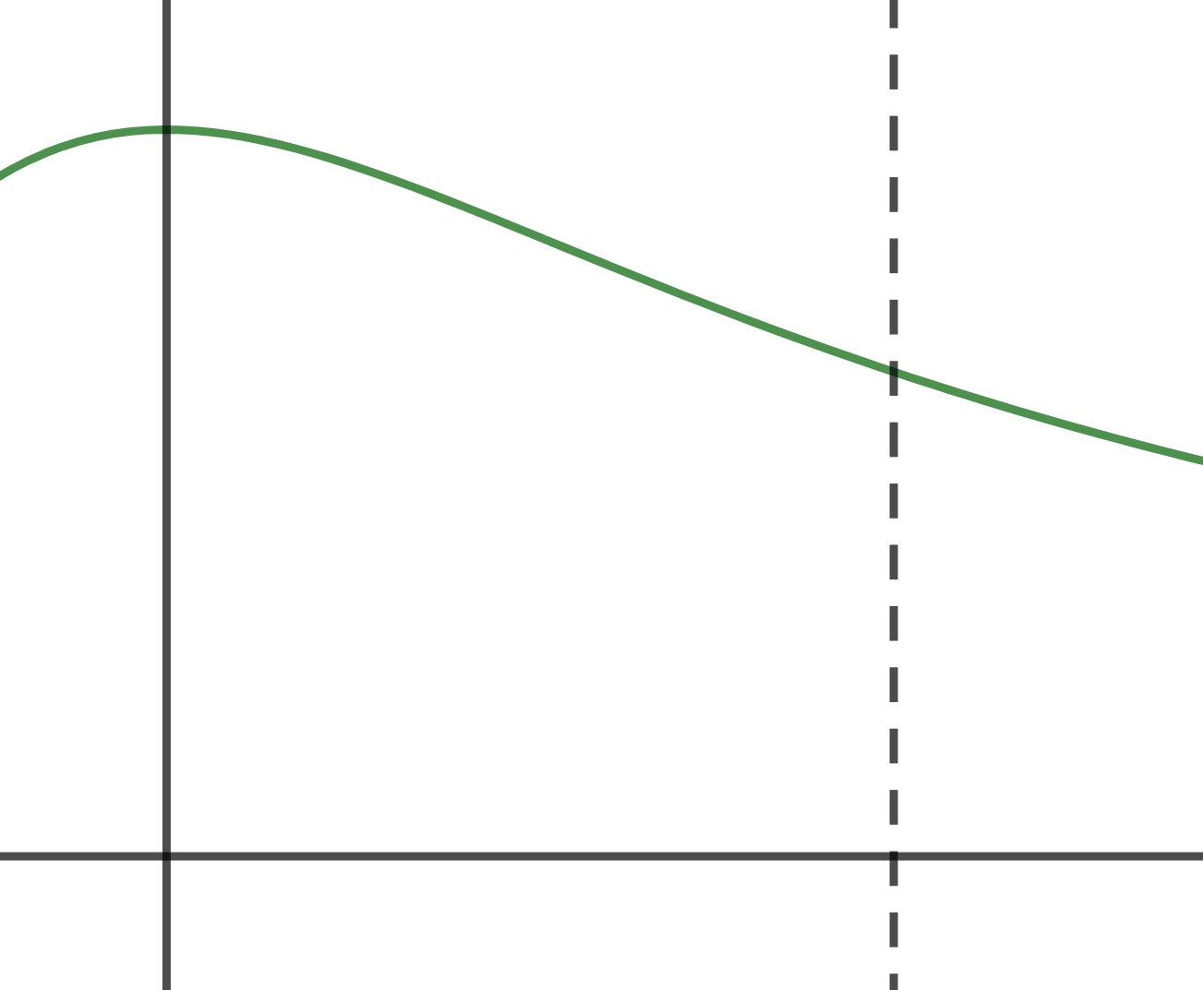
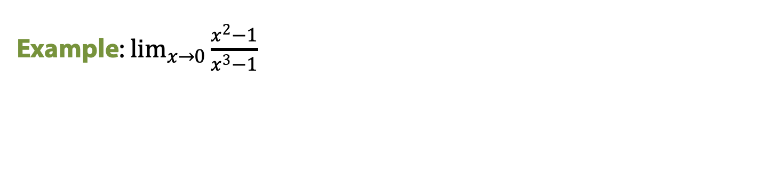
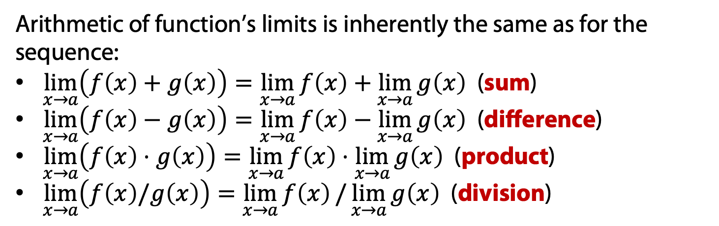
Function Limits: arithmetic
Arithmetic of function’s limits is inherently the same as for the sequence:
$\lim_{x→a}\left(f\left(x\right)+g\left(x\right)\right)=\lim_{x→a}{f\left(x\right)}+\lim_{x→a}{g\left(x\right)}$ (sum)
$\lim_{x→a}\left(f\left(x\right)−g\left(x\right)\right)=\lim_{x→a}{f\left(x\right)}−\lim_{x→a}{g\left(x\right)}$ (difference)
$\lim_{x→a}\left(f\left(x\right)⋅g\left(x\right)\right)=\lim_{x→a}{f\left(x\right)}⋅\lim_{x→a}{g\left(x\right)}$ (product)
$\lim_{x→a}\left(f\left(x\right)/g\left(x\right)\right)=\lim_{x→a}{f\left(x\right)}/\lim_{x→a}{g\left(x\right)}$ (division)
Remember: it’s only true if all the limits in the right hand side exist!
Example: $\lim_{x→0}{\frac{x^{2}−1}{x^{3}−1}}$

Slide 15

Function Limits: arithmetic
Arithmetic of function’s limits is inherently the same as for the sequence:
$\lim_{x→a}\left(f\left(x\right)+g\left(x\right)\right)=\lim_{x→a}{f\left(x\right)}+\lim_{x→a}{g\left(x\right)}$ (sum)
$\lim_{x→a}\left(f\left(x\right)−g\left(x\right)\right)=\lim_{x→a}{f\left(x\right)}−\lim_{x→a}{g\left(x\right)}$ (difference)
$\lim_{x→a}\left(f\left(x\right)⋅g\left(x\right)\right)=\lim_{x→a}{f\left(x\right)}⋅\lim_{x→a}{g\left(x\right)}$ (product)
$\lim_{x→a}\left(f\left(x\right)/g\left(x\right)\right)=\lim_{x→a}{f\left(x\right)}/\lim_{x→a}{g\left(x\right)}$ (division)
Remember: it’s only true if all the limits in the right hand side exist!
Example: $\lim_{x→1}{\frac{x^{2}−1}{x^{3}−1}}$

Slide 16
Function Limits: arithmetic
Arithmetic of function’s limits is inherently the same as for the sequence:
$\lim_{x→a}\left(f\left(x\right)+g\left(x\right)\right)=\lim_{x→a}{f\left(x\right)}+\lim_{x→a}{g\left(x\right)}$ (sum)
$\lim_{x→a}\left(f\left(x\right)−g\left(x\right)\right)=\lim_{x→a}{f\left(x\right)}−\lim_{x→a}{g\left(x\right)}$ (difference)
$\lim_{x→a}\left(f\left(x\right)⋅g\left(x\right)\right)=\lim_{x→a}{f\left(x\right)}⋅\lim_{x→a}{g\left(x\right)}$ (product)
$\lim_{x→a}\left(f\left(x\right)/g\left(x\right)\right)=\lim_{x→a}{f\left(x\right)}/\lim_{x→a}{g\left(x\right)}$ (division)
Remember: it’s only true if all the limits in the right hand side exist!
Example: $\lim_{x→1}{\frac{x^{2}−1}{x^{3}−1}}$
Remember about the indeterminate forms!

Slide 17
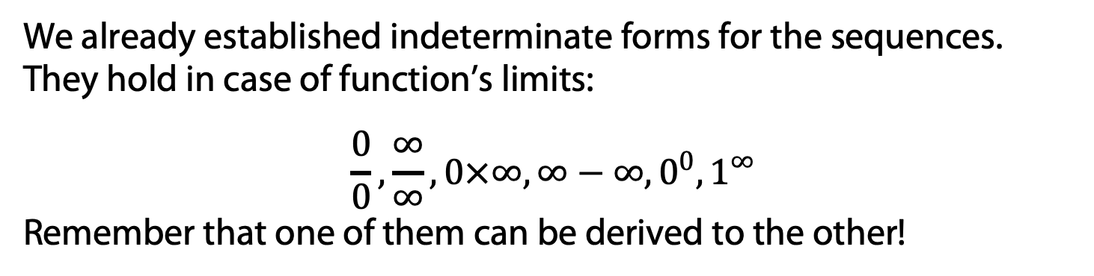
Function Limits: the indeterminate forms
We already established indeterminate forms for the sequences. They hold in case of function’s limits:
$$\frac{0}{0}, \frac{∞}{∞}, 0×∞, ∞−∞, 0^{0}, 1^{∞}$$
Remember that one of them can be derived to the other!

Slide 18
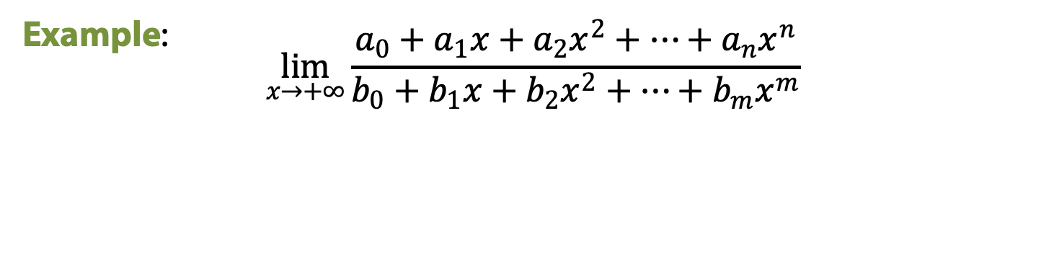
Function Limits: the indeterminate forms
We already established indeterminate forms for the sequences. They hold in case of function’s limits:
$$\frac{0}{0}, \frac{∞}{∞}, 0×∞, ∞−∞, 0^{0}, 1^{∞}$$
Remember that one of them can be derived to the other!
Example: $$\lim_{x→+∞}{\frac{a_{0}+a_{1}x+a_{2}x^{2}+…+a_{n}x^{n}}{b_{0}+b_{1}x+b_{2}x^{2}+…+b_{m}x^{m}}}$$

Slide 19
Function Limits: the boundary rule
Another usual case of easily calculated limits is the product of bounded and infinitesimal function which is, in turn, infinitesimal too.

Slide 20
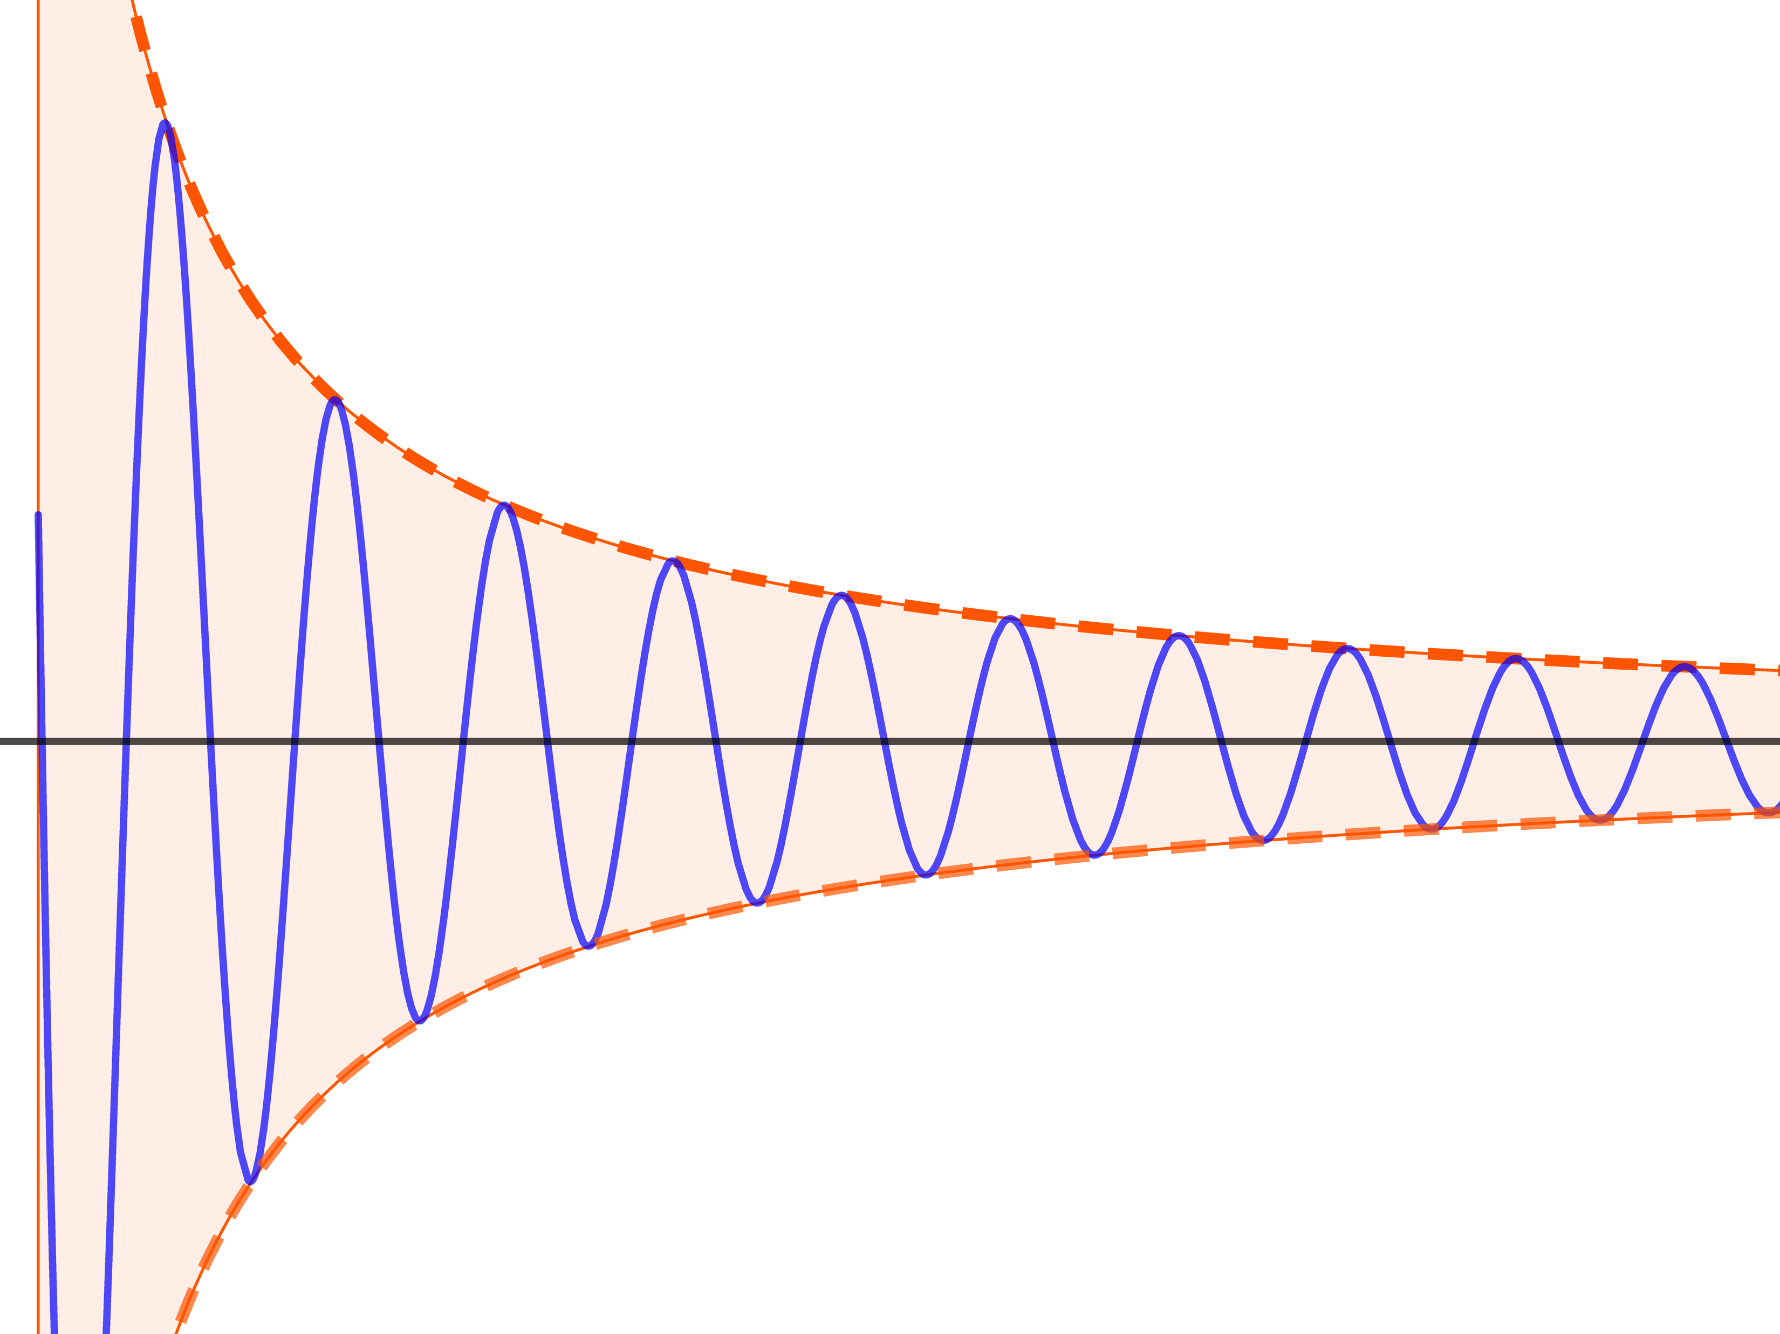
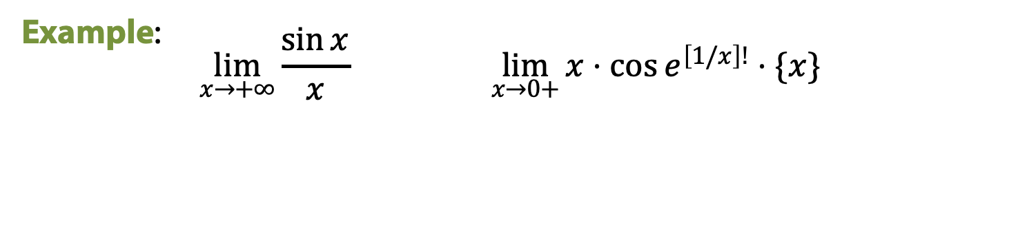
Function Limits: the boundary rule
Another usual case of easily calculated limits is the product of bounded and infinitesimal function which is, in turn, infinitesimal too.
Example: $$\lim_{x→+∞}{\frac{\sin{x}}{x}} \lim_{x→0+}{x⋅\cos{e^{\left[1/x\right]!}⋅\{x\}}}$$

Slide 21
Two important limits

Slide 22
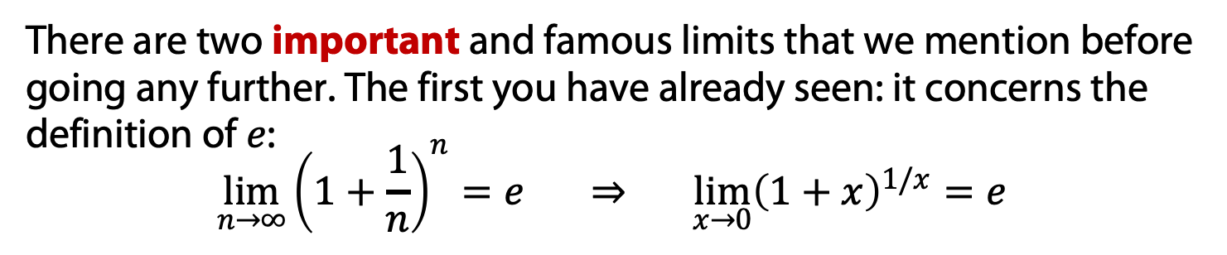
Function Limits: important limits
There are two important and famous limits that we mention before going any further. The first you have already seen: it concerns the definition of $e$:
$$\lim_{n→∞}{{\left(1+\frac{1}{n}\right)}^{n}=e ⇒ \lim_{x→0}{{\left(1+x\right)}^{1/x}=e}}$$

Slide 23
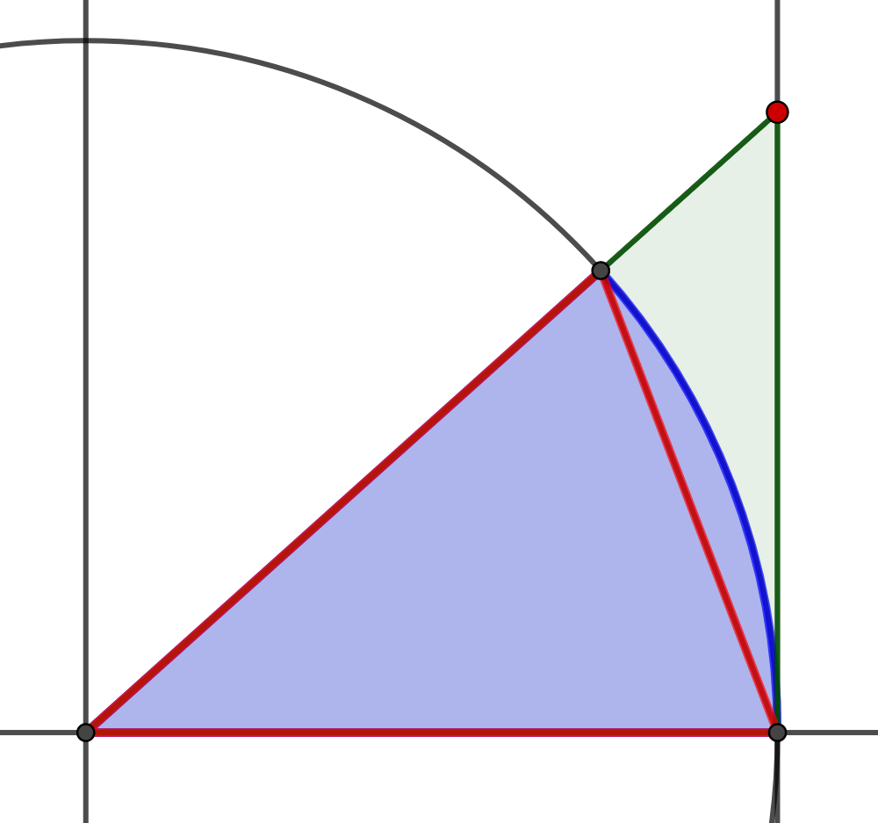
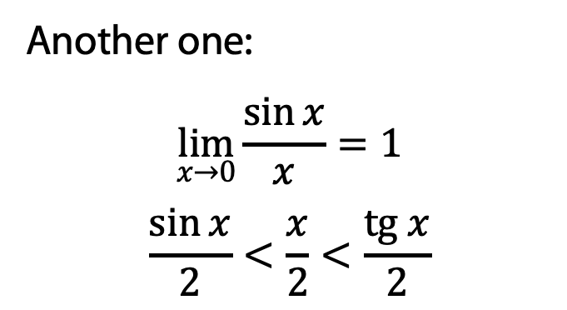
Function Limits: important limits
There are two important and famous limits that we mention before going any further. The first you have already seen: it concerns the definition of $e$:
$$\lim_{n→∞}{{\left(1+\frac{1}{n}\right)}^{n}=e ⇒ \lim_{x→0}{{\left(1+x\right)}^{1/x}=e}}$$
Another one:
$$\lim_{x→0}{\frac{\sin{x}}{x}}=1$$
$$\frac{\sin{x}}{2}<\frac{x}{2}<\frac{tg x}{2}$$

Slide 24
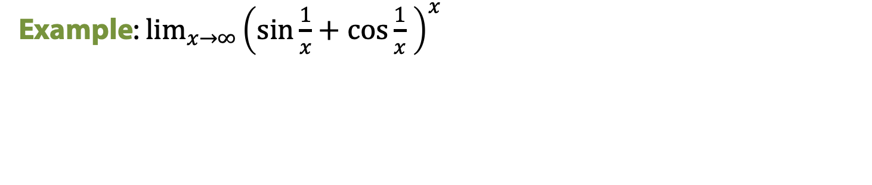
Function Limits: important limits
There are two important and famous limits that we mention before going any further. The first you have already seen: it concerns the definition of $e$:
$$\lim_{n→∞}{{\left(1+\frac{1}{n}\right)}^{n}=e ⇒ \lim_{x→0}{{\left(1+x\right)}^{1/x}=e}}$$
Another one:
$$\lim_{x→0}{\frac{\sin{x}}{x}}=1$$
$$\frac{\sin{x}}{2}<\frac{x}{2}<\frac{tg x}{2}$$
Example: $\lim_{x→∞}{{\left(\sin{\frac{1}{x}}+\cos{\frac{1}{x} }\right)}^{x}}$

Slide 25
Asymptotic notations

Slide 26
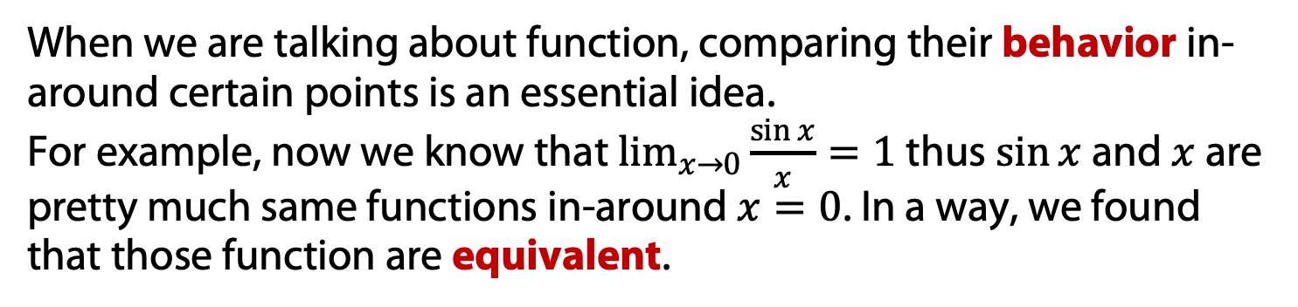
Asymptotic notation and Big-O notation
When we are talking about function, comparing their behavior in-around certain points is an essential idea.
For example, now we know that $\lim_{x→0}{\frac{\sin{x}}{x}}=1$ thus $\sin{x}$ and $x$ are pretty much same functions in-around $x=0$. In a way, we found that those function are equivalent.

Slide 27
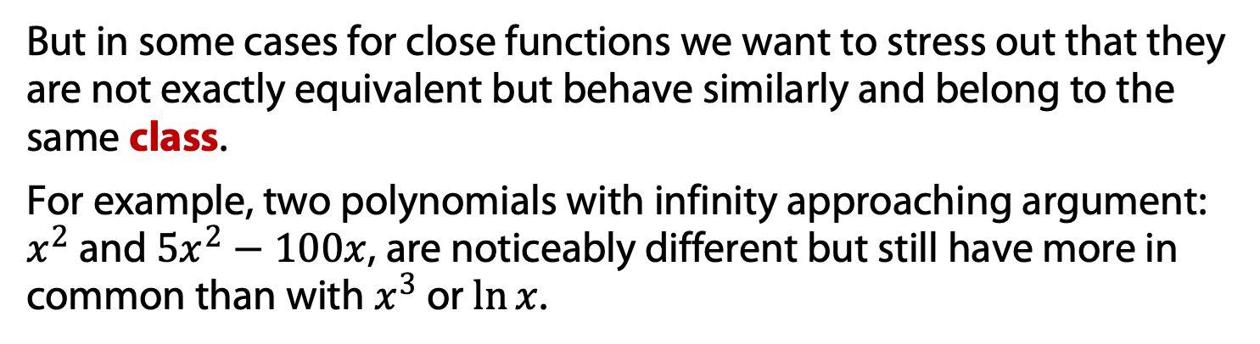
Asymptotic notation and Big-O notation
When we are talking about function, comparing their behavior in-around certain points is an essential idea.
For example, now we know that $\lim_{x→0}{\frac{\sin{x}}{x}}=1$ thus $\sin{x}$ and $x$ are pretty much same functions in-around $x=0$. In a way, we found that those function are equivalent.
But in some cases for close functions we want to stress out that they are not exactly equivalent but behave similarly and belong to the same class.
For example, two polynomials with infinity approaching argument: $x^{2}$ and $5x^{2}−100x$, are noticeably different but still have more in common than with $x^{3}$ or $\ln{x}$.

Slide 28
Asymptotic notation and Big-O notation
When we are talking about function, comparing their behavior in-around certain points is an essential idea.
For example, now we know that $\lim_{x→0}{\frac{\sin{x}}{x}}=1$ thus $\sin{x}$ and $x$ are pretty much same functions in-around $x=0$. In a way, we found that those function are equivalent.
But in some cases for close functions we want to stress out that they are not exactly equivalent but behave similarly and belong to the same class.
Or sometimes we do not seek (or do not know) details of the function amongst its class.
For example the actual time of bubble sort depends on various things such as speed of each operation, etc., but when we are comparing algorithms we are interested in the number of those operations, not the constant multiplier of the function!

Slide 29
Big-O notation

Slide 30

Big-O notation
The first basic idea of asymptotic comparison is big-O notation (sometimes written as $O$-notation).

Slide 31
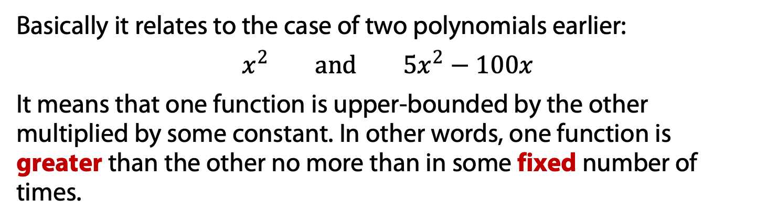
Big-O notation
The first basic idea of asymptotic comparison is big-O notation (sometimes written as $O$-notation).
Basically it relates to the case of two polynomials earlier:
$$x^{2} and 5x^{2}−100x$$
It means that one function is upper-bounded by the other multiplied by some constant. In other words, one function is greater than the other no more than in some fixed number of times.

Slide 32
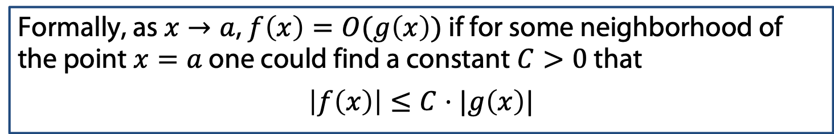
Big-O notation
The first basic idea of asymptotic comparison is big-O notation (sometimes written as $O$-notation).
Basically it relates to the case of two polynomials earlier:
$$x^{2} and 5x^{2}−100x$$
It means that one function is upper-bounded by the other multiplied by some constant. In other words, one function is greater than the other no more than in some fixed number of times.
Formally, as $x→a$, $f\left(x\right)=O(g\left(x\right))$ if for some neighborhood of the point $x=a$ one could find a constant $C>0$ that
$$\left|f\left(x\right)\right|≤C⋅|g\left(x\right)|$$

Slide 33
Big-O notation
The first basic idea of asymptotic comparison is big-O notation (sometimes written as $O$-notation).
Basically it relates to the case of two polynomials earlier:
$$x^{2} and 5x^{2}−100x$$
It means that one function is upper-bounded by the other multiplied by some constant. In other words, one function is greater than the other no more than in some fixed number of times.
Formally, as $x→a$, $f\left(x\right)=O(g\left(x\right))$ if for some neighborhood of the point $x=a$ one could find a constant $C>0$ that
$$\left|f\left(x\right)\right|≤C⋅|g\left(x\right)|$$
Example:

Slide 34
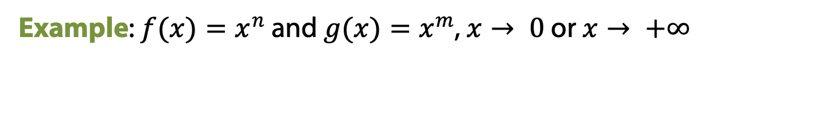
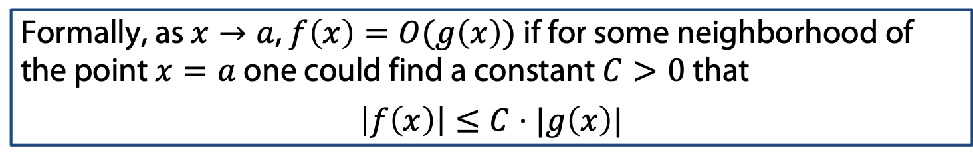

Big-O notation
Formally, as $x→a$, $f\left(x\right)=O(g\left(x\right))$ if for some neighborhood of the point $x=a$ one could find a constant $C>0$ that
$$\left|f\left(x\right)\right|≤C⋅|g\left(x\right)|$$
Example: $f(x)=x^{n}$ and $g(x)=x^{m}$, $x→ 0$ or $x→ +∞$
Example: $f(x)=\sin{x}$ and $g(x)=x^{m}$, $x→ 0$ or $x→ +∞$

Slide 35
Little-o notation

Slide 36
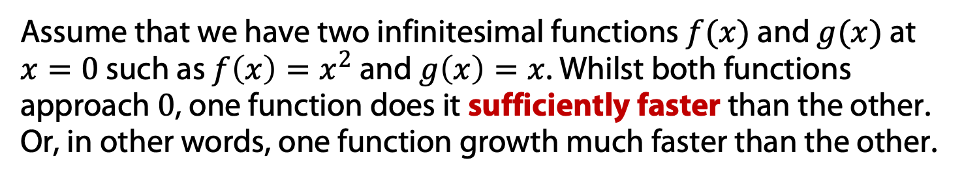
Little-o notation
Assume that we have two infinitesimal functions $f(x)$ and $g(x)$ at $x=0$ such as $f\left(x\right)=x^{2}$ and $g\left(x\right)=x$. Whilst both functions approach $0$, one function does it sufficiently faster than the other. Or, in other words, one function growth much faster than the other.

Slide 37
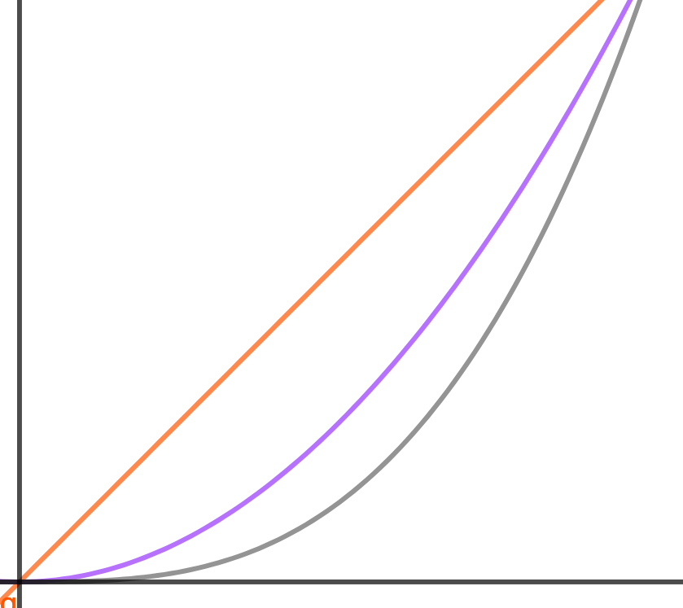
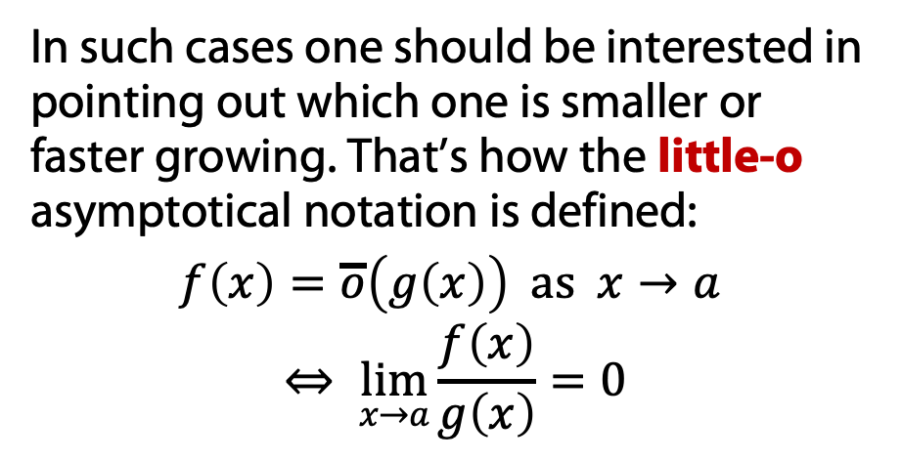
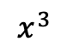
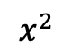
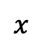
Little-o notation
Assume that we have two infinitesimal functions $f(x)$ and $g(x)$ at $x=0$ such as $f\left(x\right)=x^{2}$ and $g\left(x\right)=x$. Whilst both functions approach $0$, one function does it sufficiently faster than the other. Or, in other words, one function growth much faster than the other.
In such cases one should be interested in pointing out which one is smaller or faster growing. That’s how the little-o asymptotical notation is defined:
$$f\left(x\right)=\overline{o}\left(g\left(x\right)\right) as x→a$$ $$⇔ \lim_{x→a}{\frac{f\left(x\right)}{g\left(x\right)}=0}$$
$$x$$
$$x^{2}$$
$$x^{3}$$

Slide 38

Little-o notation
Assume that we have two infinitesimal functions $f(x)$ and $g(x)$ at $x=0$ such as $f\left(x\right)=x^{2}$ and $g\left(x\right)=x$. Whilst both functions approach $0$, one function does it sufficiently faster than the other. Or, in other words, one function growth much faster than the other.
In such cases one should be interested in pointing out which one is smaller or faster growing. That’s how the little-o asymptotical notation is defined:
$$f\left(x\right)=\overline{o}\left(g\left(x\right)\right) as x→a$$ $$⇔ \lim_{x→a}{\frac{f\left(x\right)}{g\left(x\right)}=0}$$
$$x$$
$$x^{2}$$
$$x^{3}$$
In other words, $f\left(x\right)=\overline{o}(g\left(x\right))$ means that
$$f\left(x\right)=α\left(x\right)⋅g\left(x\right) where \lim_{x→a}{α(x)}=0$$

Slide 39
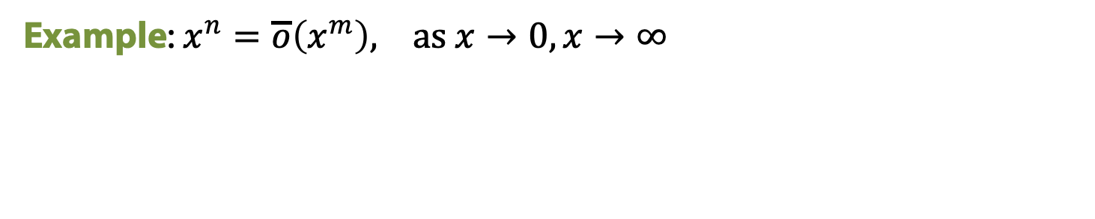
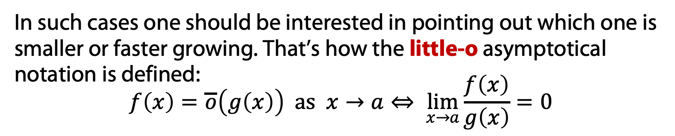

Little-o notation
In such cases one should be interested in pointing out which one is smaller or faster growing. That’s how the little-o asymptotical notation is defined:
$$f\left(x\right)=\overline{o}\left(g\left(x\right)\right) as x→a⇔ \lim_{x→a}{\frac{f\left(x\right)}{g\left(x\right)}=0}$$
Example: $x^{n}=\overline{o}\left(x^{m}\right), as x→0, x→∞$
Example: $sin x=\overline{o}\left(x\right), as x→0, x→∞$

Slide 40

Little-o notation
In other words, $f\left(x\right)=\overline{o}(g\left(x\right))$ means that
$$f\left(x\right)=α\left(x\right)⋅g\left(x\right) where \lim_{x→a}{α(x)}=0$$

Slide 41
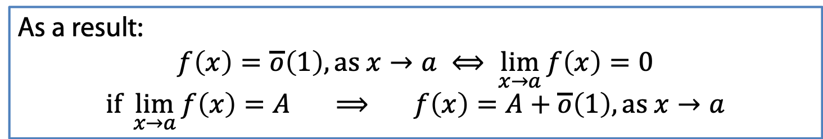
Little-o notation
In other words, $f\left(x\right)=\overline{o}(g\left(x\right))$ means that
$$f\left(x\right)=α\left(x\right)⋅g\left(x\right) where \lim_{x→a}{α(x)}=0$$
As a result:
$$f\left(x\right)=\overline{o}\left(1\right), as x→a ⟺ \lim_{x→a}{f\left(x\right)=0}$$
$$if \lim_{x→a}{f\left(x\right)=A ⟹ f\left(x\right)=A+\overline{o}\left(1\right), as x→a}$$

Slide 42
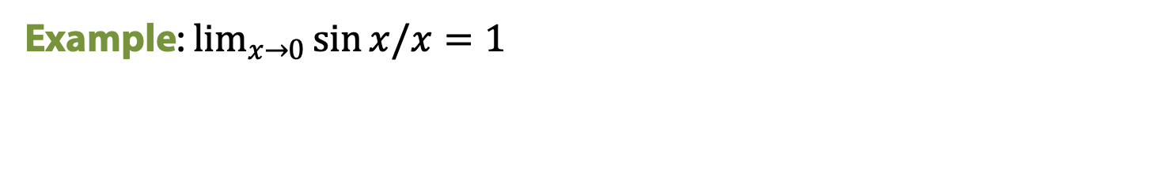
Little-o notation
In other words, $f\left(x\right)=\overline{o}(g\left(x\right))$ means that
$$f\left(x\right)=α\left(x\right)⋅g\left(x\right) where \lim_{x→a}{α(x)}=0$$
As a result:
$$f\left(x\right)=\overline{o}\left(1\right), as x→a ⟺ \lim_{x→a}{f\left(x\right)=0}$$
$$if \lim_{x→a}{f\left(x\right)=A ⟹ f\left(x\right)=A+\overline{o}\left(1\right), as x→a}$$
Example: $\lim_{x→0}{\sin{x/x}=1}$

Slide 43
Asymptotic and binomials

Slide 44

Asymptotic and binomials
Now let consider asymptotic of object we have been studying for a while: binomial coefficients
Firstly, let us show that ($l<k<n)$:
$$\frac{n−l}{k−l}>\frac{n}{k}$$

Slide 45

Asymptotic and binomials
Now let consider asymptotic of object we have been studying for a while: binomial coefficients
Firstly, let us show that ($l<k<n)$:
$$\frac{n−l}{k−l}>\frac{n}{k}$$
Thus we get $${\left(\frac{n}{k}\right)}^{k}≤\left(\begin{matrix}n \\ k\end{matrix}\right)$$

Slide 46

Asymptotic and binomials
Now let consider asymptotic of object we have been studying for a while: binomial coefficients
Firstly, let us show that ($l<k<n)$:
$$\frac{n−l}{k−l}>\frac{n}{k}$$
Thus we get $${\left(\frac{n}{k}\right)}^{k}≤\left(\begin{matrix}n \\ k\end{matrix}\right)$$
Easy to add here $${\left(\frac{n}{k}\right)}^{k}≤\left(\begin{matrix}n \\ k\end{matrix}\right)≤\frac{n^{k}}{k!}$$

Slide 47

Asymptotic and binomials
Let us also consider some more intrinsic Stirling asymptotic rule:
$$n!∼\sqrt{2πn}{\left(\frac{n}{e}\right)}^{n} which implies \frac{1}{n!}<{\left(\frac{e}{n}\right)}^{n}$$

Slide 48

Asymptotic and binomials
Let us also consider some more intrinsic Stirling asymptotic rule:
$$n!∼\sqrt{2πn}{\left(\frac{n}{e}\right)}^{n} which implies \frac{1}{n!}<{\left(\frac{e}{n}\right)}^{n}$$
Thus another result: $${\left(\frac{n}{k}\right)}^{k}≤\left(\begin{matrix}n \\ k\end{matrix}\right)≤\frac{n^{k}}{k!}≤{\left(\frac{e⋅n}{k}\right)}^{k}$$

Slide 49

Asymptotic and binomials
Let us also consider some more intrinsic Stirling asymptotic rule:
$$n!∼\sqrt{2πn}{\left(\frac{n}{e}\right)}^{n} which implies \frac{1}{n!}<{\left(\frac{e}{n}\right)}^{n}$$
Thus another result: $${\left(\frac{n}{k}\right)}^{k}≤\left(\begin{matrix}n \\ k\end{matrix}\right)≤\frac{n^{k}}{k!}≤{\left(\frac{e⋅n}{k}\right)}^{k}$$
To finalize our binomial asymptotic we get:
$$\left(\begin{matrix}2n \\ n\end{matrix}\right)∼\frac{2^{2n}}{\sqrt{πn}}$$

Slide 50
Multivariate functions: definitions

Slide 51
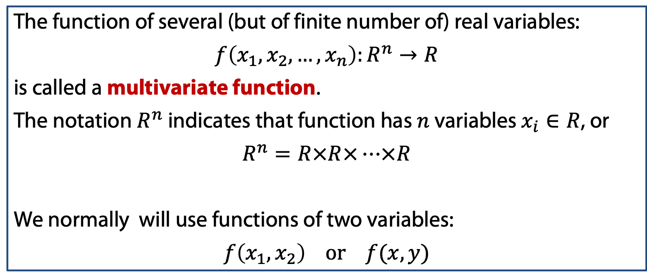
Multivariate functions
The function of several (but of finite number of) real variables:
$$f\left(x_{1},x_{2},…,x_{n}\right):R^{n}→R$$
is called a multivariate function.
The notation $R^{n}$ indicates that function has $n$ variables $x_{i}∈R$, or
$$R^{n}=R×R×…×R$$
We normally will use functions of two variables:
$$f\left(x_{1},x_{2}\right) or f(x,y)$$
N times

Slide 52
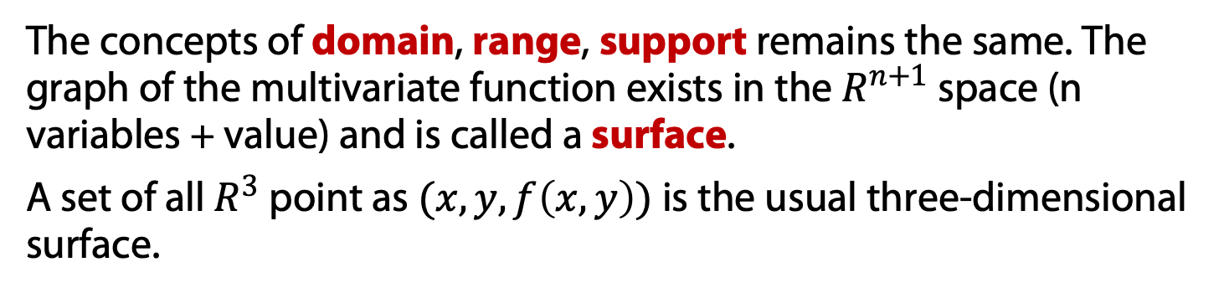
Multivariate functions
The function of several (but of finite number of) real variables:
$$f\left(x_{1},x_{2},…,x_{n}\right):R^{n}→R$$
is called a multivariate function.
The notation $R^{n}$ indicates that function has $n$ variables $x_{i}∈R$, or
$$R^{n}=R×R×…×R$$
We normally will use functions of two variables:
$$f\left(x_{1},x_{2}\right) or f(x,y)$$
N times
The concepts of domain, range, support remains the same. The graph of the multivariate function exists in the $R^{n+1}$ space (n variables + value) and is called a surface.
A set of all $R^{3}$ point as $(x,y,f\left(x,y\right))$ is the usual three-dimensional surface.

Slide 53

Multivariate functions
A set of all $R^{3}$ point as $(x,y,f\left(x,y\right))$ is the usual three-dimensional surface.
Normally it is pretty comprehensive to provide interpretable plot of the surface. Instead the following plane concept of the function structure commonly used.

Slide 54
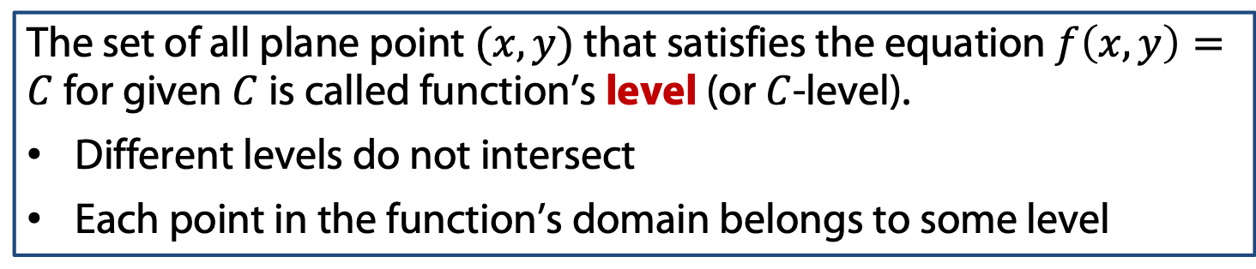
Multivariate functions
A set of all $R^{3}$ point as $(x,y,f\left(x,y\right))$ is the usual three-dimensional surface.
Normally it is pretty comprehensive to provide interpretable plot of the surface. Instead the following plane concept of the function structure commonly used.
The set of all plane point $(x,y)$ that satisfies the equation $f\left(x,y\right)=C$ for given $C$ is called function’s level (or $C$-level).
Different levels do not intersect
Each point in the function’s domain belongs to some level

Slide 55
Multivariate functions
A set of all $R^{3}$ point as $(x,y,f\left(x,y\right))$ is the usual three-dimensional surface.
Normally it is pretty comprehensive to provide interpretable plot of the surface. Instead the following plane concept of the function structure commonly used.
The set of all plane point $(x,y)$ that satisfies the equation $f\left(x,y\right)=C$ for given $C$ is called function’s level (or $C$-level).
Different levels do not intersect
Each point in the function’s domain belongs to some level
Example: $f\left(x,y\right)=x+2y$

Slide 56
Multivariate functions
A set of all $R^{3}$ point as $(x,y,f\left(x,y\right))$ is the usual three-dimensional surface.
Normally it is pretty comprehensive to provide interpretable plot of the surface. Instead the following plane concept of the function structure commonly used.
The set of all plane point $(x,y)$ that satisfies the equation $f\left(x,y\right)=C$ for given $C$ is called function’s level (or $C$-level).
Different levels do not intersect
Each point in the function’s domain belongs to some level
Example: $f\left(x,y\right)=\max{\{\left|x\right|,\left|y\right|\}}$

Slide 57
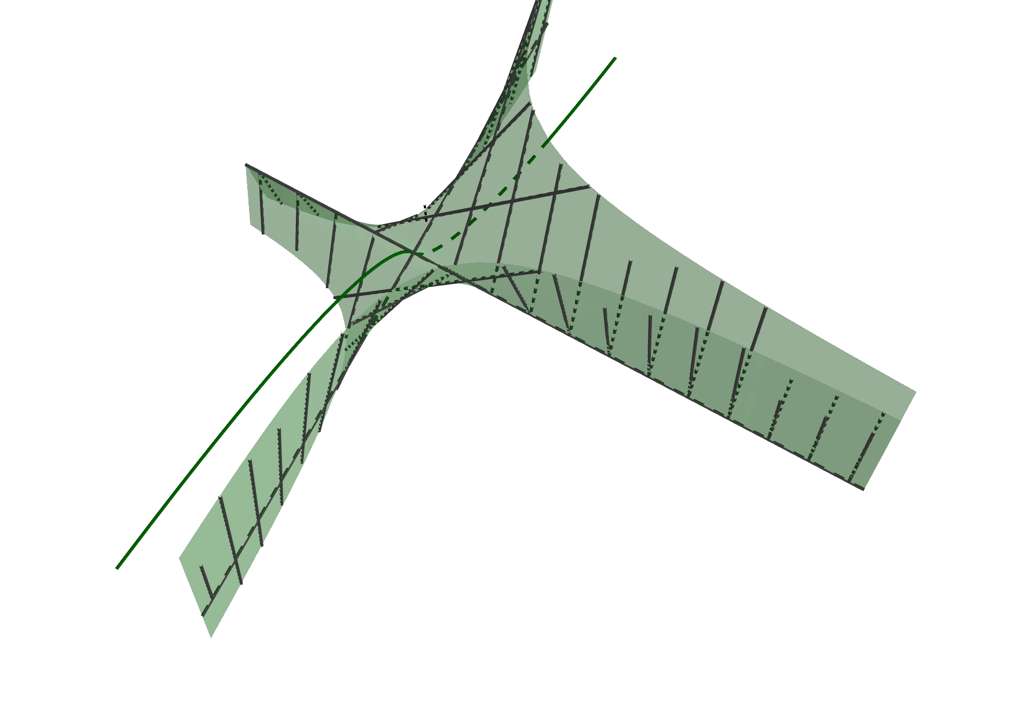
Multivariate functions
A set of all $R^{3}$ point as $(x,y,f\left(x,y\right))$ is the usual three-dimensional surface.
Normally it is pretty comprehensive to provide interpretable plot of the surface. Instead the following plane concept of the function structure commonly used.
The set of all plane point $(x,y)$ that satisfies the equation $f\left(x,y\right)=C$ for given $C$ is called function’s level (or $C$-level).
Different levels do not intersect
Each point in the function’s domain belongs to some level
Example: $f\left(x,y\right)=\max{\{\left|x\right|,\left|y\right|\}}$

Slide 58
Multivariate functions
A set of all $R^{3}$ point as $(x,y,f\left(x,y\right))$ is the usual three-dimensional surface.
Normally it is pretty comprehensive to provide interpretable plot of the surface. Instead the following plane concept of the function structure commonly used.
The set of all plane point $(x,y)$ that satisfies the equation $f\left(x,y\right)=C$ for given $C$ is called function’s level (or $C$-level).
Different levels do not intersect
Each point in the function’s domain belongs to some level
Example: $f\left(x,y\right)=x^{2}+y^{2}$

Slide 59
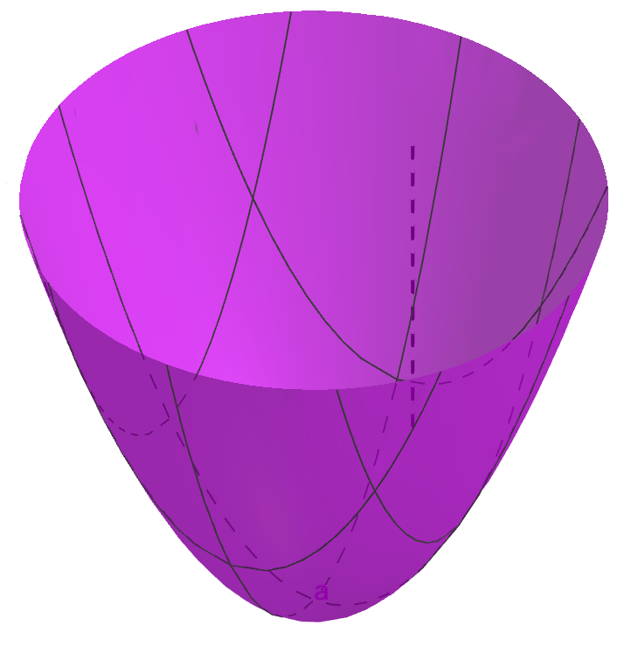
Multivariate functions
A set of all $R^{3}$ point as $(x,y,f\left(x,y\right))$ is the usual three-dimensional surface.
Normally it is pretty comprehensive to provide interpretable plot of the surface. Instead the following plane concept of the function structure commonly used.
The set of all plane point $(x,y)$ that satisfies the equation $f\left(x,y\right)=C$ for given $C$ is called function’s level (or $C$-level).
Different levels do not intersect
Each point in the function’s domain belongs to some level
Example: $f\left(x,y\right)=x^{2}+y^{2}$

Slide 60
Multivariate functions: limits

Slide 61
Multivariate functions: limits
As earlier we need to define the function’s limit. We try to extrapolate the whole principle “it is the value that resembles our function in some neighborhood of the point the most (except the point itself)”.

Slide 62
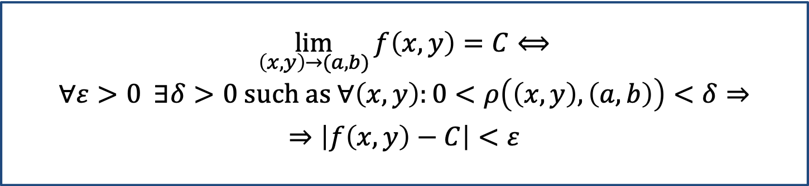
Multivariate functions: limits
As earlier we need to define the function’s limit. We try to extrapolate the whole principle “it is the value that resembles our function in some neighborhood of the point the most (except the point itself)”.
$$\lim_{\left(x,y\right)→(a,b)}{f\left(x,y\right)=C⟺}$$
$$∀ε>0 ∃δ>0 such as ∀\left(x,y\right):0<ρ\left(\left(x,y\right),\left(a,b\right)\right)<δ⇒$$
$$⇒\left|f\left(x,y\right)−C\right|<ε$$

Slide 63
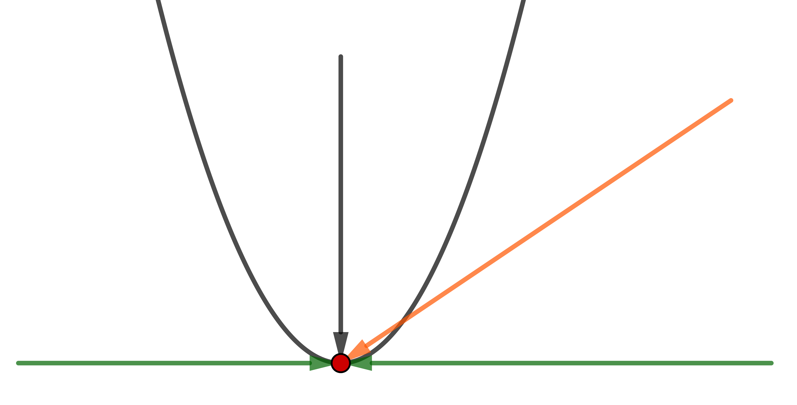
Multivariate functions: limits
As earlier we need to define the function’s limit. We try to extrapolate the whole principle “it is the value that resembles our function in some neighborhood of the point the most (except the point itself)”.
$$\lim_{\left(x,y\right)→(a,b)}{f\left(x,y\right)=C⟺}$$
$$∀ε>0 ∃δ>0 such as ∀\left(x,y\right):0<ρ\left(\left(x,y\right),\left(a,b\right)\right)<δ⇒$$
$$⇒\left|f\left(x,y\right)−C\right|<ε$$
We need to consider all possible approaches to the limit point!
Variable-wise limit will not suffice!

Slide 64
Multivariate functions: limits
Basic ideas to calculate multivariate limits:
to prove its absence: find a pair of approaches with different limits;
to calculate it: try to use only functions of single variables

Slide 65

Multivariate functions: limits
Basic ideas to calculate multivariate limits:
to prove its absence: find a pair of approaches with different limits;
to calculate it: try to use only functions of single variables
Example:
$$\lim_{\left(x,y\right)→(2,1)}{x^{2}y+y+5y^{5}x+{\left(x+\frac{y}{2}\right)}^{2}}$$

Slide 66
Multivariate limits: examples

Slide 67

Multivariate functions: limits
Basic ideas to calculate multivariate limits:
to prove its absence: find a pair of approaches with different limits;
to calculate it: try to use only functions of single variables
Example:
$$\lim_{\left(x,y\right)→(0,a)}{\frac{\sin\left(xy\right)}{x}}$$

Slide 68
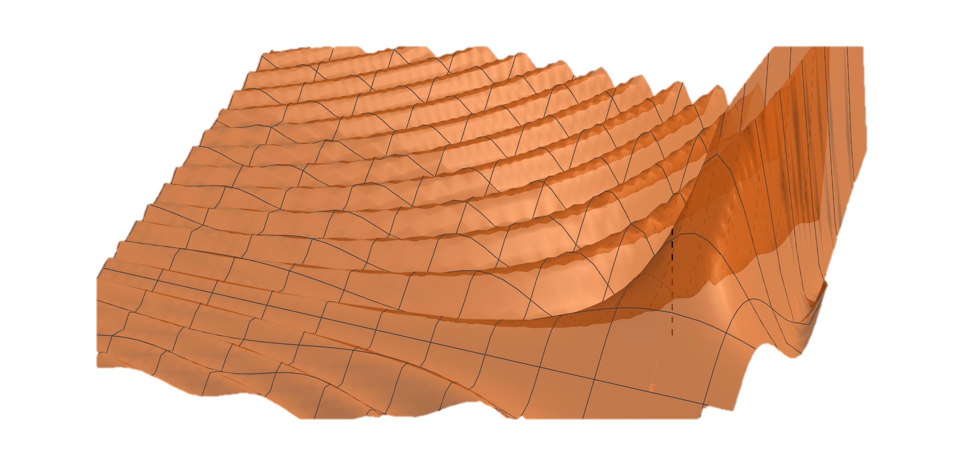
Multivariate functions: limits
Basic ideas to calculate multivariate limits:
to prove its absence: find a pair of approaches with different limits;
to calculate it: try to use only functions of single variables
Example:
$$\lim_{\left(x,y\right)→(0,a)}{\frac{\sin\left(xy\right)}{x}}$$

Slide 69

Multivariate functions: limits
Basic ideas to calculate multivariate limits:
to prove its absence: find a pair of approaches with different limits;
to calculate it: try to use only functions of single variables
Example:
$$\lim_{\left(x,y\right)→(0,0)}{\frac{xy}{x^{2}+y^{2}}}$$

Slide 70
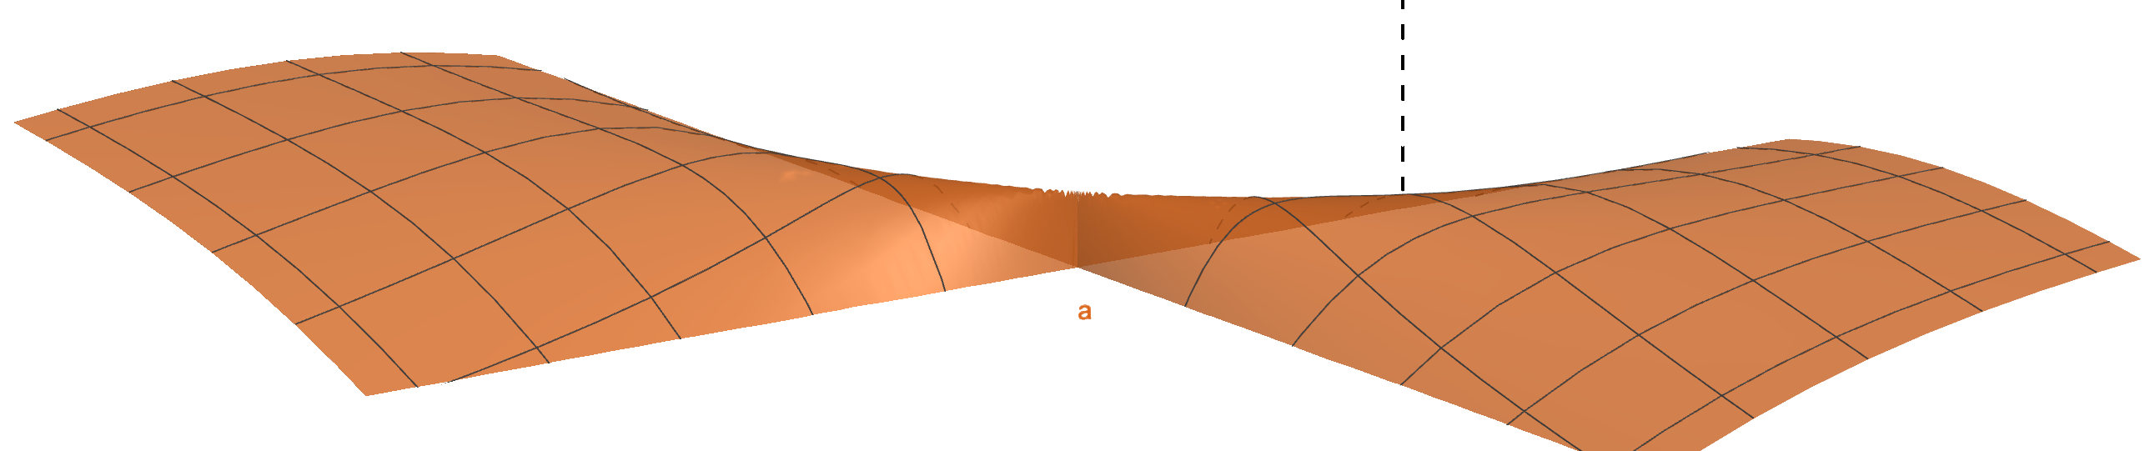
Multivariate functions: limits
Basic ideas to calculate multivariate limits:
to prove its absence: find a pair of approaches with different limits;
to calculate it: try to use only functions of single variables
Example:
$$\lim_{\left(x,y\right)→(0,0)}{\frac{xy}{x^{2}+y^{2}}}$$

Slide 71

Multivariate functions: limits
Basic ideas to calculate multivariate limits:
to prove its absence: find a pair of approaches with different limits;
to calculate it: try to use only functions of single variables
Example:
$$\lim_{\left(x,y\right)→(0,0)}{\frac{x^{2}y}{x^{2}+y^{2}}}$$

Slide 72
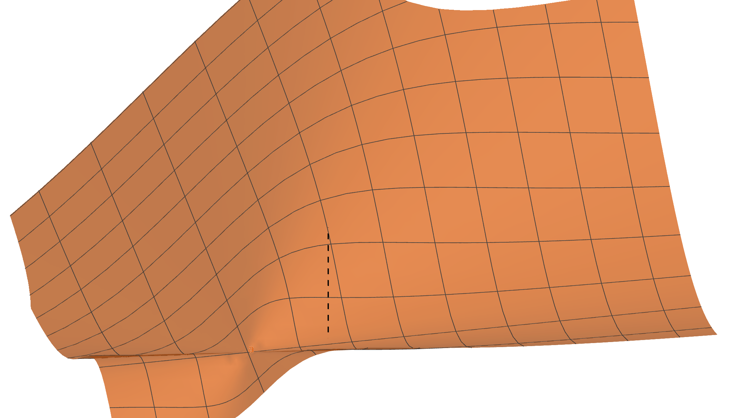
Multivariate functions: limits
Basic ideas to calculate multivariate limits:
to prove its absence: find a pair of approaches with different limits;
to calculate it: try to use only functions of single variables
Example:
$$\lim_{\left(x,y\right)→(0,0)}{\frac{x^{2}y}{x^{2}+y^{2}}}$$

Slide 73
Multivariate functions: limits
Basic ideas to calculate multivariate limits:
to prove its absence: find a pair of approaches with different limits;
to calculate it: try to use only functions of single variables
Example:
$$\lim_{\left(x,y\right)→(0,0)}{\frac{x^{2}y}{x^{2}+y^{2}}}$$

Slide 74
Limits and multivariate functions

